Slide 1
INDIAN INSTITUTE OF TECHNOLOGY ,PALAKAD, KERALA. PROJECT NAME: "Impedance Tuning using Maury 2640D Slide Screw Tuner"
PV INDUMATHI ,(2ND) YEAR
PAAVAI ENGINEERING COLLEGE,NAMAKKAL.
SUMMER FELLOW INTERNSHIP UNDER: Dr. ARVIND AJOY
ASSISTANT PROFFESOR ,ELECTRICAL DEPARTMENT

Slide 2
SLIDE SCREW IMPEDANCE TUNER MAURY 2640D
AIM:
To study and stimulate the operation of the Maury 2640D slide screw impedance tuner for achieving accurate impedance matching in RF and microwave system.

Slide 3
OBJECTIVES:
To understand the mechanical and electrical concept.
To analyse how the position of the tuning probes affects impedance.
To model the tuner structure in stimulation software in Ansys student electronic version.
To observe impedance variation using a smith chart.
To explore real-time RF Applications like load pull measurements and amplifier testing.

Slide 4
What is a Slide Screw Impedance Tuner?
A Slide Screw Impedance Tuner (like the Maury 2640D) is a precision RF test instrument that lets engineers change the impedance seen by a device under test (DUT) — like a transistor, amplifier, or antenna — without modifying the physical circuit.
In RF design (especially at GHz frequencies), impedance matching is everything.
This tuner lets "manually create different load conditions" to:
Optimize power transfer
Measure behavior under mismatched loads
Characterize nonlinear devices (like power amplifiers) THANK YOU

Slide 5
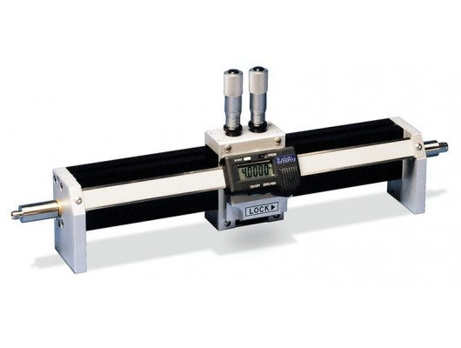
🛠️ ABOUT MAURY 2640D
Feature | Detail
📶 Frequency Range | Up to 18 GHz (depends on model)
🧱 Type | Slide screw mechanical tuner
⚙️ Working | Uses movable slugs/screws and a transmission line to vary impedance
📐 Precision | High — used in load-pull and source-pull measurements
Load-pull = Changing load impedance and measuring DUT output Source-pull = Changing source impedance and seeing input match

Slide 6
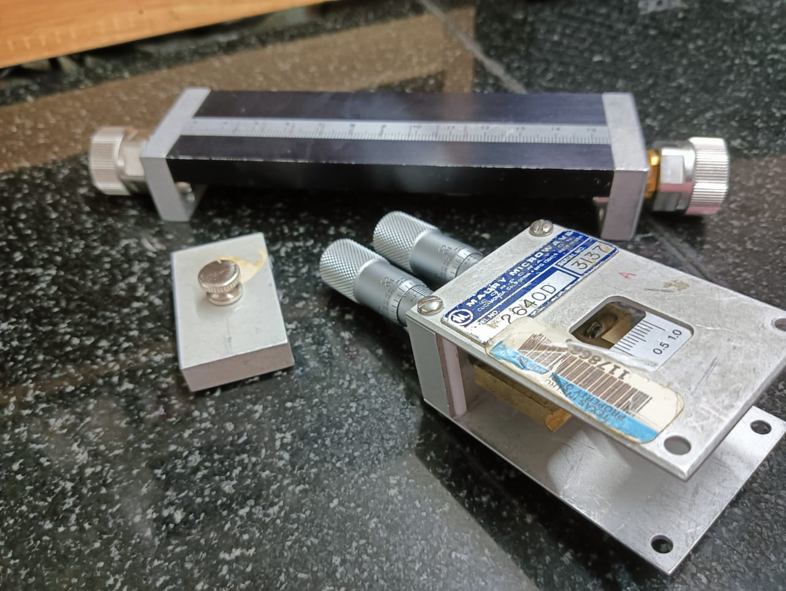
Working Principle
• Uses movable carriage and tuning slugs/screws
• Adjusts impedance by altering transmission line properties
• Mechanical movement → impedance transformation
• Allows manual impedance control at RF ports

Slide 7
✅ Applications of RF Impedance Tuners (like Maury 2640D)
📡 1. Power Amplifier Design & Testing
To find the best impedance for maximum power output
Used in load-pull testing — vary load impedance and analyze performance
Helps in tuning gain, efficiency, and linearity
📶 2. Transistor Characterization
Test how RF transistors behave under different source/load impedances
Helps in modeling and improving S-parameters and small/large signal models
🛰️ 3. Impedance Matching in RF Circuits
Match the device to source/load at high frequencies (GHz)
Reduce reflection (S11) and maximize power transfer
📈 4. Smith Chart Based Analysis
Tuner lets you manually move impedance point on Smith Chart
Helps visualize tuning process and learn practical RF concepts

Slide 8
LOAD PULL IMPEDANCE
“Load-pull” concept is very important in RF tuning and analysis.
Load-Pull Impedance Matching – How It Works in RF Tuner (like Maury 2640D).
In Maury 2640D Slide Screw RF Tuner, we manually change the impedance by adjusting sliding screws and probes inside a transmission line. When RF signal passes through, part of it reflects based on how we set the tuner . By adjusting the tuner,
we can "pull" the load impedance to any point on the Smith chart.
This allows us to : Simulate real-world mismatches Identify optimal load impedance for best performance Study how the DUT behaves under non-ideal conditions We then use VNA (Vector Network Analyzer) to measure S-parameters and observe power, gain, VSWR etc.
Why Load-Pull is Important :
In power amplifier design, we can find which impedance gives maximum output power . Helps in designing efficient and stable circuits. Used in radar, satellite and wireless RF systems.

Slide 9
CONCLUSION: The Radar Frequency enables precise impedance matching for accurate RF measurements, optimizing power transfer and device performance. Motorized control further improves speed, repeatability, and automation in testing.

Slide 10
THANK YOU

